Slide 1
Modeling Noisy Labels for Facial Expression Recognition
Group member: Mingjian Zhu, Hongxun Ding, Lanjing Yi
Supervisor Dan Zeng, Bo Tang
Inspector Ming Tang
January 12, 2022

Slide 2
Contents
Background
Method
Observation experiments
Performance comparison
Summary

Slide 3
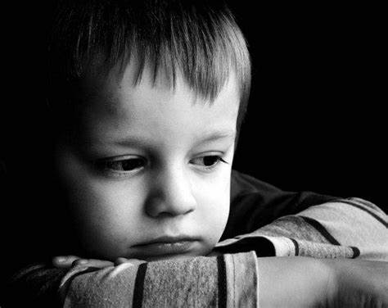
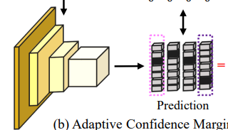
Background: Problem
Facial Expression Recognition(FER), a classification problem. The inputs is human facial image and the outputs is single emotion class.
Sad
Happy

Slide 4
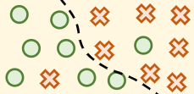
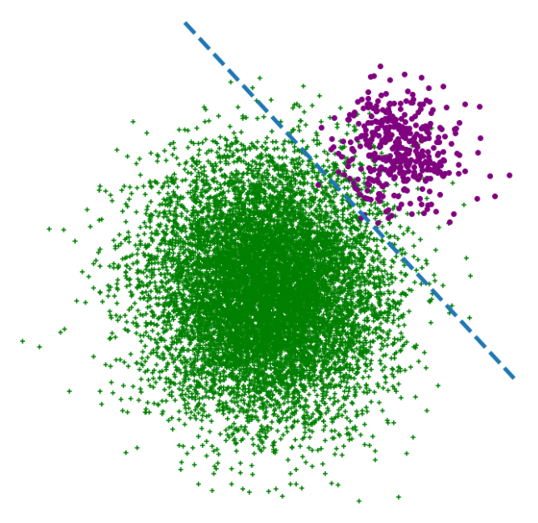
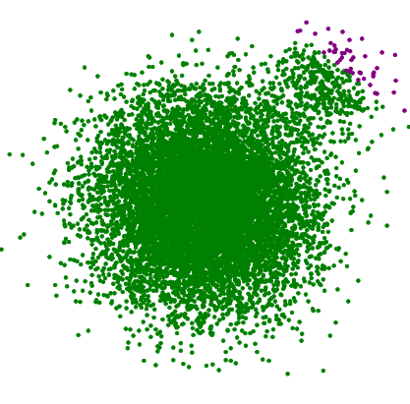
Background: Challenges
Noisy labels in dataset: Model tends to overfit to noisy samples.
Long-tailed class distribution: Model tends to overfit to major classes.
Ground truth
Model prediction with bias
Ground truth
Model prediction with bias

Slide 5
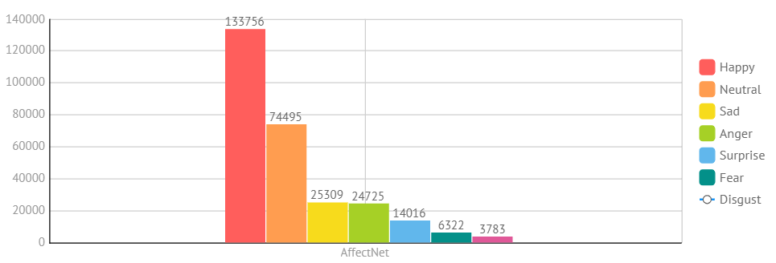
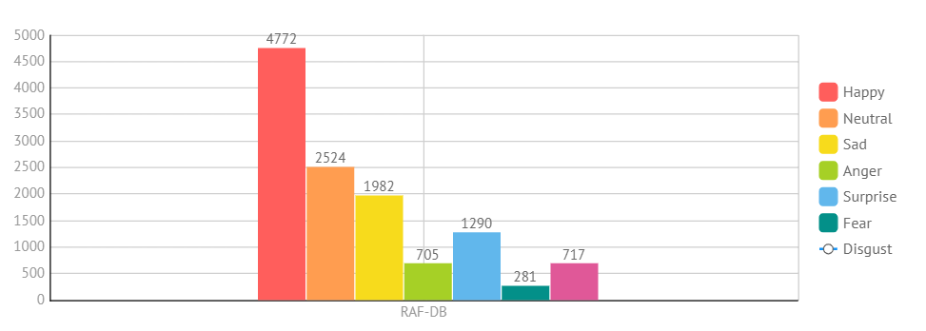
Background: Datasets
FER Benchmarks: AffectNet, RAF-DB.

Slide 6
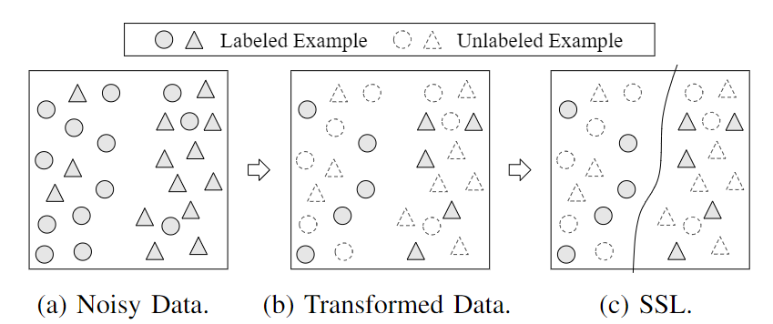
DivideMix: Remove noisy labels
Divide training set into labeled set and unlabeled set.
Use Semi-Supervised Learning(SSL) Method.

Slide 7
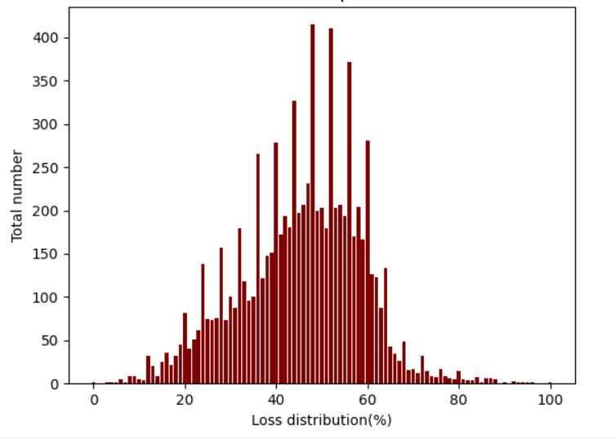
Divide labeled and unlabeled
Fit a Gaussian Mixture Model to the loss distribution using the Expectation-Maximization algorithm.
Our improvement is from division among all training set to division on each class.

Slide 8
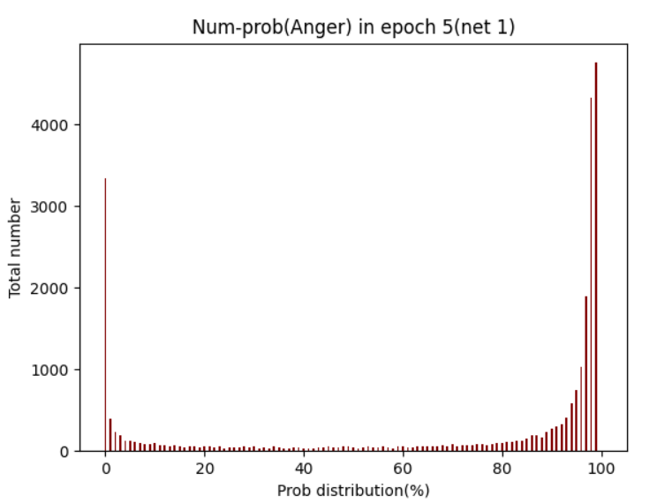
Divide labeled and unlabeled
For each class, manually set the threshold according to class distribution. Use the clean probability of each sample to divide it into clean set or noisy set.

Slide 9
Adaptive confidence margin
Better utilize the unlabeled data.
Classify an unlabeled sample by compare its loss with confidence margin.
Calculate confidence margin among labeled set.

Slide 10
How to calculate confidence margins?
Core idea:
, B = 0.97, γ = e.

Slide 11
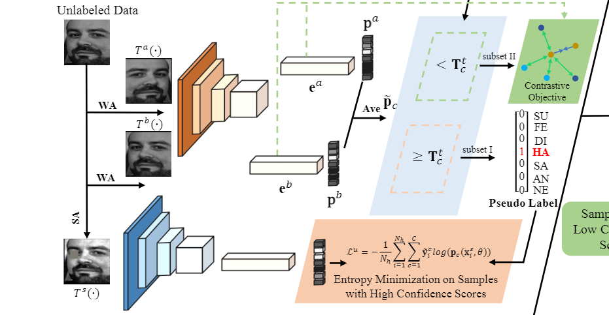
Ada-CM unlabeled part
Confidence Margin Tc

Slide 12
Results on AffectNet
Nearly accuracy using relatively less labeled data.
Method | Accuracy | #Labeled data
Ours | 57% | 45%~64%
Supervised learning | 58% | 100%

Slide 13
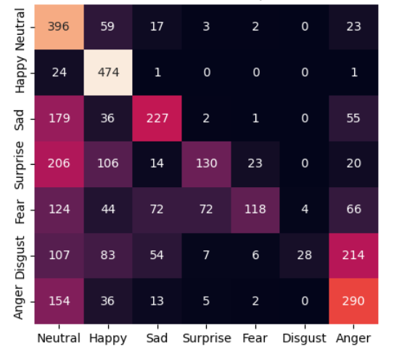
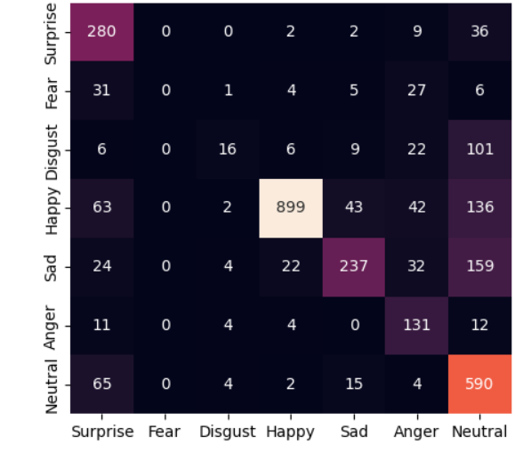
Observation experiments
Class distribution is different between RAF-DB and AffectNet, need to change the threshold.
Confusion matrix on AffectNet.
Confusion matrix on RAF-DB.

Slide 14
Performance comparison(compared with SL)
Performance comparison on AffectNet.
Method | Accuracy | #Labeled data number
Ours (without feature loss) | 57% | nearly 180k
Supervised learning | 58% | 287k
Performance comparison on RAF-DB.
Method | Accuracy | #Labeled data number
Ours (without feature loss) | 79.13% | nearly 4000
Ours | 81.59% | nearly 4000
Supervised learning | 84.13% | 12271
Our method works on RAF-DB as well.

Slide 15
Performance comparison(compare with Ada-CM)
Performance comparison on RAF-DB.
Method | Accuracy | Labeled data size(in each epoch)
Ours | 81.59% | nearly 4000
Ada-CM | 84.42% | 4000
Our method explicitly combat noise challenge. However, GMM division ignores lost of “hard-clean sample”, whose loss is high and label is correct.
This is the main reason for the accuracy gap between ours and Ada-CM.

Slide 16
Summary: What we have done?
Improve DivideMix method, change the division method and adapt it among AffectNet, RAF-DB.
Learn Ada-CM, an implicitly combating noise method.
Achieve a near-SOTA accuracy.

Slide 17
Summary: Future work
Learn how to classify the “hard-clean sample” correctly.

Slide 18
References
Li, J., Socher, R., & Hoi, S. C. (2020). Dividemix: Learning with noisy labels as semi-supervised learning. arXiv preprint arXiv:2002.07394.
Li, H., Wang, N., Yang, X., Wang, X., & Gao, X. (2022). Towards Semi-Supervised Deep Facial Expression Recognition with An Adaptive Confidence Margin. In Proceedings of the IEEE/CVF Conference on Computer Vision and Pattern Recognition (pp. 4166-4175).
Ting Chen, Simon Kornblith, Mohammad Norouzi, and Ge- offrey Hinton. A simple framework for contrastive learning of visual representations. In ICML, pages 1597–1607, 2020.

Slide 19
Thanks!

