Slide 1



Group meeting
Zelin Li (黎泽林)
12132338@mail.sustech.edu.cn

Slide 2

Current Progress
观察实验改进
  Add 2 baselines: PULSE, PSFRGAN
  Train baselines by datasets with different attribute distribution
新版方法的设计与实现
  Attribute representation
  Pseudo pair strategy
  Input attribute by probability

Slide 3
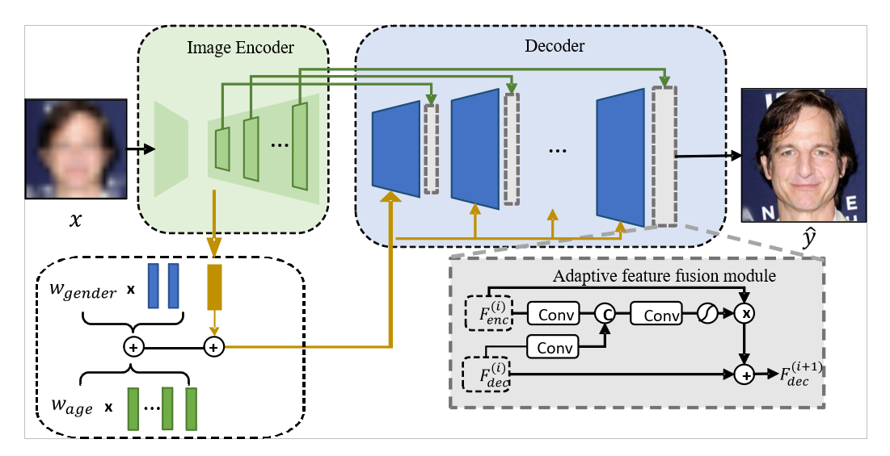
Attribute representation

Slide 4




Pseudo pair strategy
$$L_{class}$$
Real pair
$$L_{rec}$$
SR model
$$L_{class}$$
Pseudo pair
SR model
$$L_{rec}$$

Slide 5
Input attribute by probability
The model can get rid of the dependence on the GT label by receiving attribute prediction from the predictor.
Instead of only receiving the one-hot label, The model accepts label with probability :
  20-30: 0.7
  30-40: 0.3

Slide 6
Current Result
16x celeba | Age Accuracy↑ | Gender Accuracy↑ | PSNR↑ | SSIM↑ | FID↓ | NIQE↓
PFSRGAN | 0.4933 | 0.965 | 21.71 | 0.6173 | 55.88 | 3.982
AACNN(GT attribute input) | 0.564 | 0.97 | 22.65 | 0.6052 | 59.80 | 4.132
GFPGAN | 0.55 | 0.966 | 21.96 | 0.6350 | 49.53 | 4.508
GPEN | 0.523 | 0.9667 | 22.12 | 0.6152 | 47.39 | 3.877
VQFR | 0.494 | 0.9633 | 20.48 | 0.5699 | 52.09 | 3.350
Ours
LR predictor | 0.4857 | 0.9587
LR Label | 0.5033 | 0.9687 | 21.73 | 0.6227 | 50.47 | 4.348
Weighted Average | 0.5183 | 0.964 | 21.76 | 0.6233 | 50.07 | 4.344
Top2 Average | 0.5217 | 0.963 | 21.75 | 0.6232 | 50.12 | 4.347
GT Label | 0.739 | 0.986 | 21.71 | 0.6215 | 49.09 | 4.325

Slide 7
16x celeba | Age Accuracy↑ | Gender Accuracy↑
PFSRGAN | 0.4933 | 0.965
AACNN(GT attribute input) | 0.564 | 0.97
GFPGAN | 0.495 | 0.9583
GPEN | 0.523 | 0.9667
VQFR | 0.494 | 0.9633
Ours
LR predictor | 0.4857 | 0.9587
Top2 wo pseudo | 0.533 | 0.971
Top2 w pseudo | 0.5357 | 0.971

Slide 8
Future Plan
Ablation study for “Pseudo pair” strategy
Performance improvement
  LR predictor improvement
  Tune on model with good restoration performance
Complete observation, micro experiments
Paper revision

