Slide 1
Group meeting
Zelin Li (黎泽林)
12132338@mail.sustech.edu.cn

Slide 2
Current progress
1. 确定了模型的结构设计,实现了adaptive feature fusion, bottleneck等结构
2. 确定了需要使用的4个数据集, 并测试baseline 的各种性能指标
3. Ablation study
4. 撰写论文初稿

Slide 3
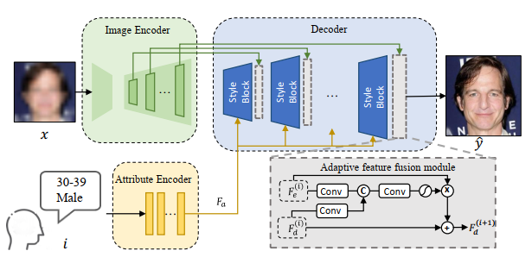
Current progress

Slide 4
Current progress
FFHQ | NIQE↓ |  | FID↓ |  | PSNR↑ |  | SSIM↑ |  | Age MAE↓ |  | Gender wrong num(727)↓
bilinear | 16.65 | 17.27 | 197.0 | 337.6 | 23.11 | 19.93 | 0.6871 | 0.6371 | 8.883 | 14.38 | 113 | 251
GFPGAN | 4.44 | 4.376 | 36.09 | 42.96 | 21.67 | 19.03 | 0.6331 | 0.5782 | 5.43 | 7.939 | 45 | 61
GPEN | 3.70 | 3.568 | 37.86 | 45.76 | 21.82 | 19.11 | 0.6069 | 0.5450 | 6.39 | 9.81 | 52 | 98
VQFR | 3.279 | 3.310 | 43.79 | 72.64 | 20.47 | 18.55 | 0.5711 | 0.5192 | 5.708 | 10.41 | 54 | 159
our | 4.105 | 4.173 | 35.68 | 46.00 | 21.59 | 18.14 | 0.6244 | 0.5527 | 4.21 | 5.55 | 18 | 48

Slide 5
Current progress
Celeba | NIQE↓ |  | FID↓ |  | PSNR↑ |  | SSIM↑ |  | Age MAE↓ |  | Gender wrong num↓(3000)
bilinear | 16.59 | 17.29 | 213.33 | 339.1 | 23.25 | 20.09 | 0.6951 | 0.6443 | 8.285 | 13.66 | 431 | 943
GFPGAN | 4.508 | 4.45 | 49.53 | 54.6 | 21.956 | 19.32 | 0.6350 | 0.5790 | 5.33 | 7.46 | 103 | 208
GPEN | 3.877 | 3.707 | 47.39 | 52.31 | 22.12 | 19.30 | 0.6152 | 0.5512 | 5.59 | 8.28 | 100 | 247
VQFR | 3.350 | 3.354 | 52.09 | 62.97 | 20.48 | 18.74 | 0.5699 | 0.5253 | 6.186 | 10.01 | 110 | 521
our | 4.090 | 4.168 | 46.40 | 51.58 | 21.79 | 18.26 | 0.6266 | 0.5539 | 4.03 | 4.67 | 48 | 125

Slide 6
Current progress
 | IMDB |  |  |  | SCFace
 | NIQE↓ | FID↓ | Age MAE↓ | Gender↓ (4414) | NIQE↓ | FID↓ | Age MAE↓ | Gender↓ (520)
GFPGAN | 4.594 | 43.20 | 6.659 | 60 | 4.064 | 101.8 | 12.708 | 126
GPEN | 4.719 | 54.1332 | 6.249 | 51 | 3.914 | 114.5 | 12.50 | 24
VQFR | 3.53961 | 33.40443652 | 6.704 | 72 | 3.279 | 128.5 | 10.50 | 21
our | 4.1561 | 34.41 | 4.027 | 30 | 4.141 | 123.0 | 7.953 | 23

Slide 7
Future Plan
1.撰写论文初稿剩余的部分
2.硕士开题报告准备

